Slide 1
TMDB Movie Dataset Analysis
Data Analysis Project Presentation Student Name
Date

Slide 2
1.
Introduction
Analysis of The Movie Database (TMDB) dataset
Comprehensive examination of movie industry trends and patterns
Focus on financial performance, audience reception, and production characteristics

Slide 3
Research Questions
What factors contribute to a movie's financial success?
2. Problem Definition
How do production budgets influence revenue and ROI?
What relationships exist between audience ratings and financial performance?
How have movie characteristics evolved over time?

Slide 4


Business Value
Guide investment decisions in film production
Optimize budget allocation
Understand audience preferences
Identify profitable market segments

Slide 5
Source
TMDB Movie Dataset
342,267 unique movies after cleaning
20 features including financial, temporal, and
categorical data
Time span: Multiple decades of film data
Key Features
Financial: Budget, Revenue, ROI
Audience Reception: Vote Average, Vote Count
Production: Runtime, Genres, Production Companies
Temporal: Release Dates
Descriptive: Title, Overview, Keywords
3. Dataset Overview

Slide 6
Handled missing values
Removed unnecessary columns
4. Exploratory Data Analysis
Standardized dates
Created derived features (ROI, release year/month)
Removed duplicates and outliers
4.1 Data Cleaning Process

Slide 7
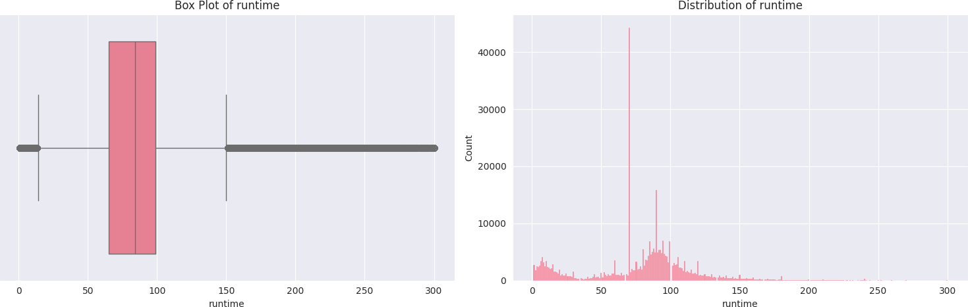
4.2 Key Visualizations
Distribution Analysis
  Runtime: Most movies between 64- 100minutes
  Vote averages: Normal distribution
  Revenue/Budget: Right-skewed distribution

Slide 8
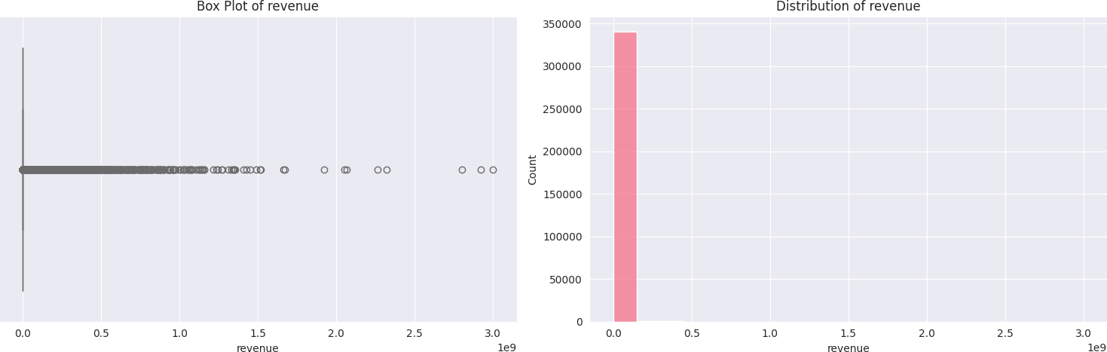
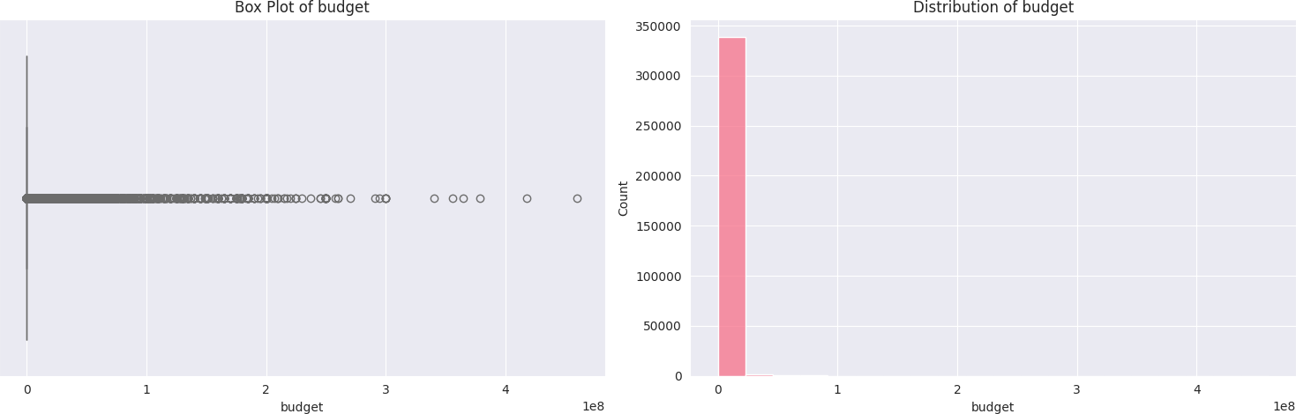
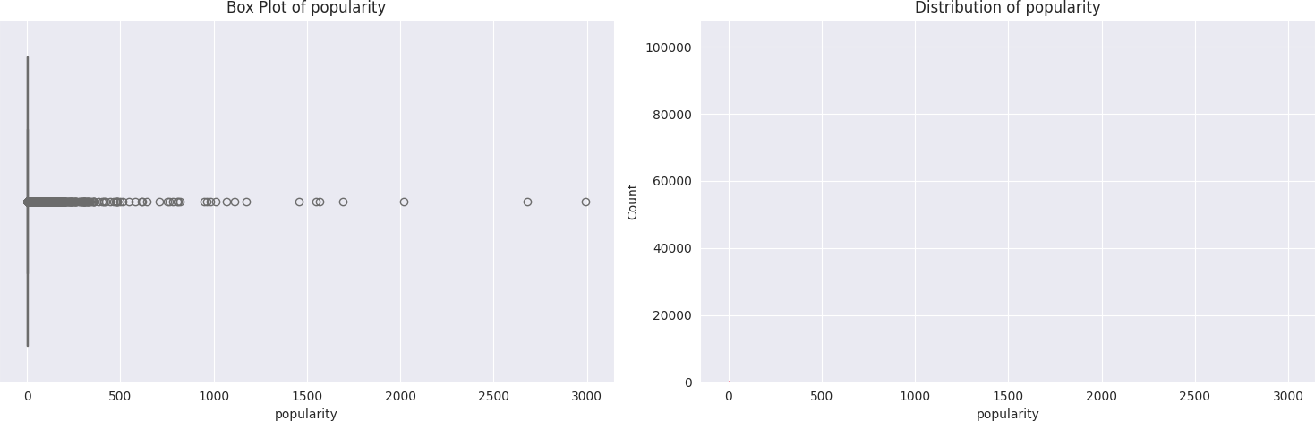
Outlier Analysis
Box plots reveal extreme values in:
  Revenue distribution
  Budget allocation
  Popularity metrics

Slide 9
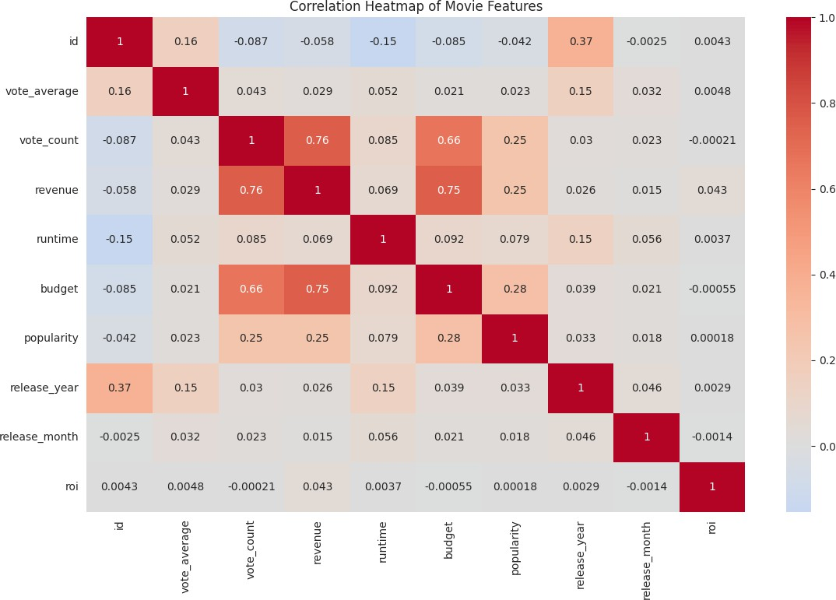
Correlation Analysis
Strong positive correlation (0.75) between budget and revenue
Moderate correlation between vote
count and financial metrics
Weak correlation between runtime and other metrics

Slide 10
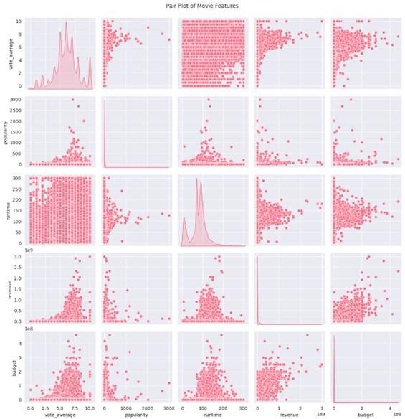
Strong budget-revenue correlation suggests higher
investments often lead to higher returns
However, outliers indicate some low-budget films can achieve significant success
Movie ratings follow a normal distribution
High ratings don't guarantee high popularity or
revenue
Suggests quality and commercial success aren't always aligned
Runtime shows little correlation with success metrics
Suggests focusing on content quality over length
Most successful films fall within standard runtime
ranges
Industry shows a "blockbuster" pattern where few movies capture most revenue
High budget films tend to generate higher revenue but with varying ROI

Slide 11
5. Results and Insights
  Financial Patterns
    Mean revenue: $2.11M
    High variance in ROI
    Budget strongly predicts revenue
5.2 Production Characteristics
Optimal runtime range identified
Genre influence on success
Studio performance variations

Slide 12
5.3 Audience Reception
Vote patterns
Popularity metrics
Rating correlations
6. Technical Implementation
Python-based analysis
Libraries: Pandas, NumPy, Seaborn, Matplotlib
Custom functions and classes
Exception handling
Data transformation techniques

Slide 13
7. Conclusions
Key Findings:
Strong budget-revenue relationship
Audience ratings impact financial success
Genre diversity affects market performance
Production quality indicators
  Recommendations:
Budget optimization strategies
Genre selection guidance
Production planning insights
Marketing focus areas

Slide 14
Future Work
  Deep learning predictions
  Sentiment analysis of reviews
  Real-time data integration
  Market segment analysis

Slide 15
G. Referenceз
https://www.kaggle.com/datasets/juzershakir/tmdb-movies- dataset

Slide 16



Thank you for your attention!

